Slide 1


Portfolio
Building Visualization in Tableau for Business Intelligence
Owner: Ketut Nikastri Tussning Putri
Page | 01

Slide 2
Introduction to Data Visualization
Definition | Data visualization is a graphical representation of information and data
Purspose | Helps understand patterns, trends and outliers in data.
Benefits | Simplify information, support decision making, and facilitate business analysis.
Importance | In the era of Big Data, data visualization facilitates big data analysis and helps data-driven decisions.
Page | 02

Slide 3

Tableau Basics – Overview & Environment
What is Tableau?: A Business Intelligence (BI) tool that helps connect, visualize, and share data for better decision-making.
Key Products: Tableau Desktop (visualization creation), Tableau Server & Online (collaboration & sharing), Tableau Public (free version for public sharing).
•Environment: Tableau consists of multiple components including Sheets, Dashboards, and Stories that help users organize and present data effectively.
Page | 03

Slide 4
Data Preparation in Tableau
Connecting Data
Join Data
Page | 04

Slide 5
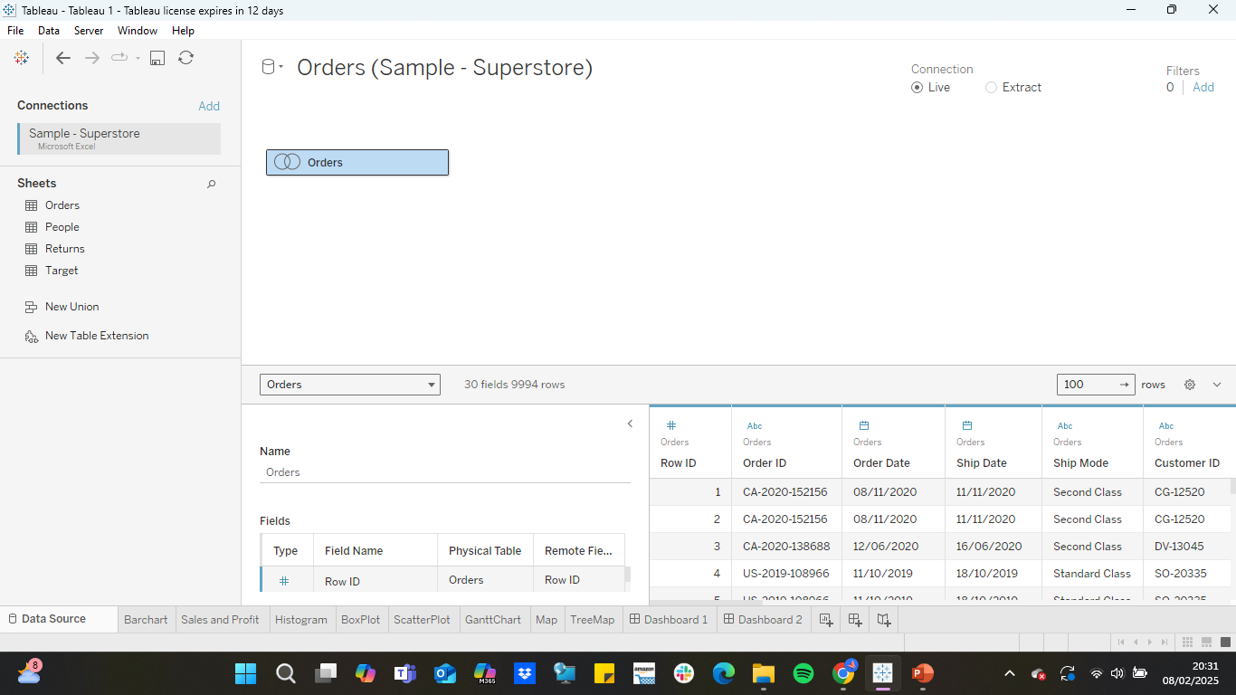
Data Preparation in Tableau
Joining Data
Page | 05

Slide 6
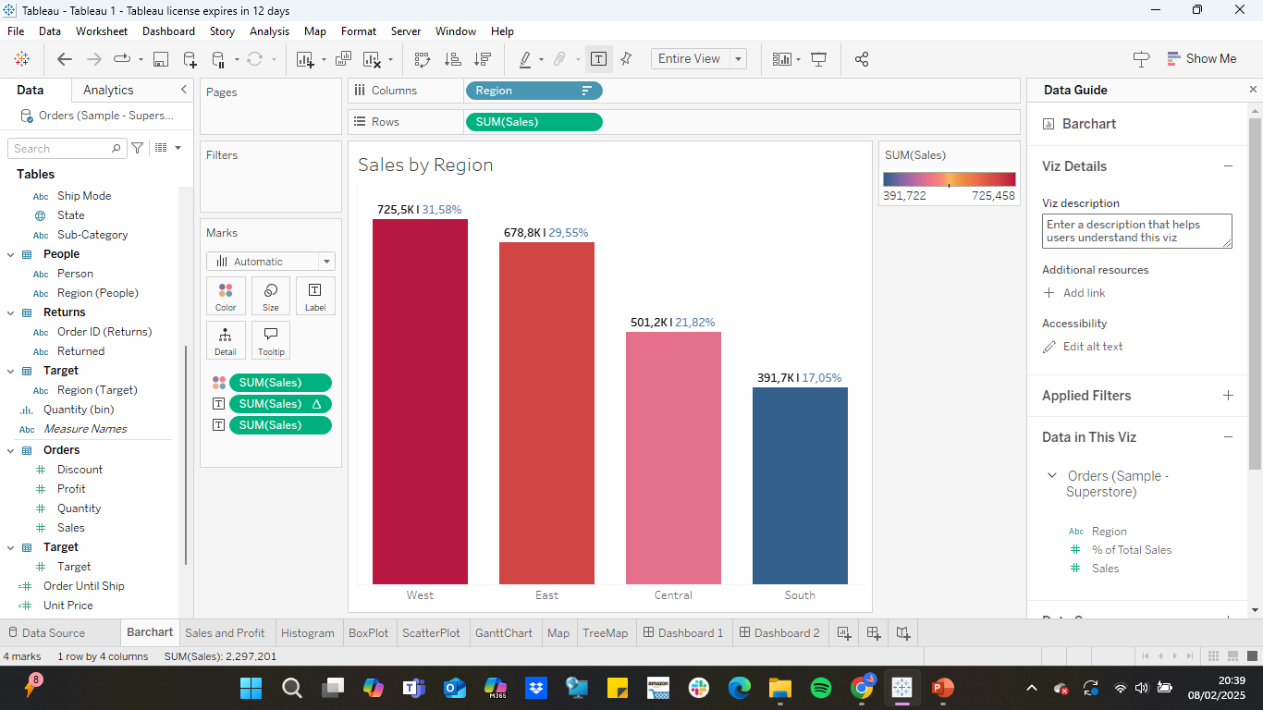
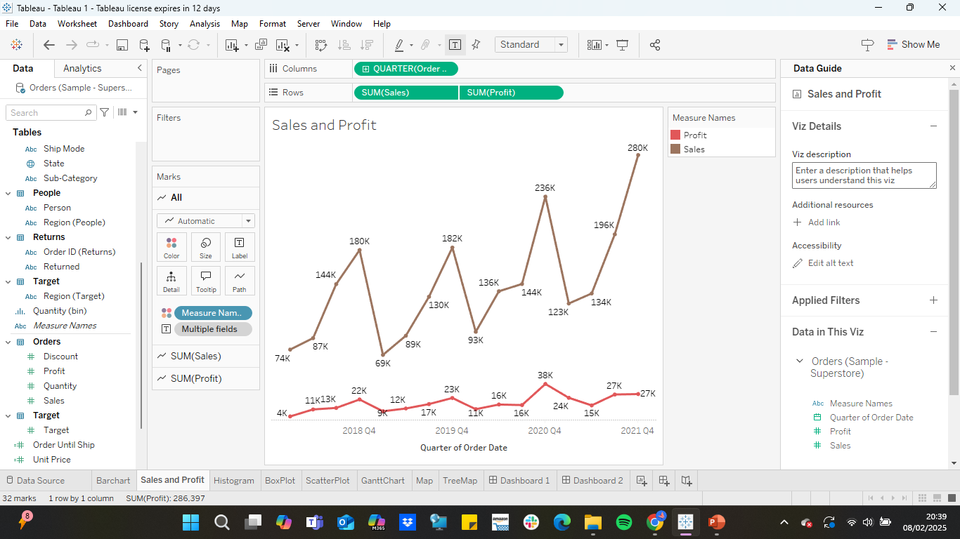
Building Charts in Tableau
Bar Chart & Line Chart
Bar Chart
Line Chart
Description: Comparing data between categories
Description: Visualize relationships between data points over a period of time to identify meaningful trends and patterns.
Page | 06

Slide 7
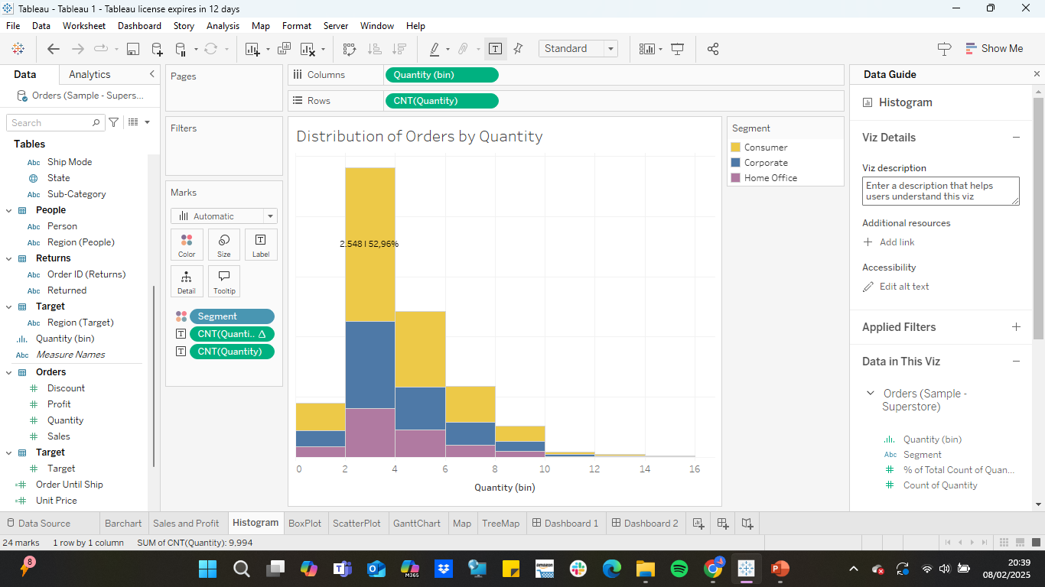
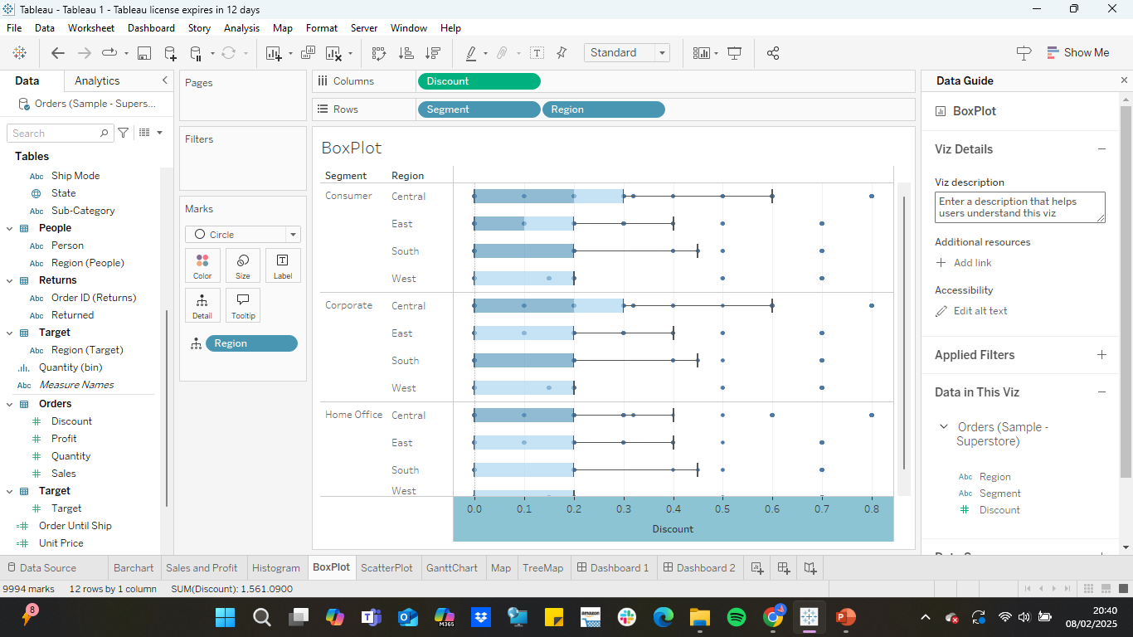
Building Charts in Tableau
Histogram & Box and Whisker
Histogram
Box and Whisker
Description: Visualization of Data Distribution and Grouping of Values ​​in a Certain Range
Description: Displaying Distribution of Data Points Based on Selected Measure
Page | 07

Slide 8
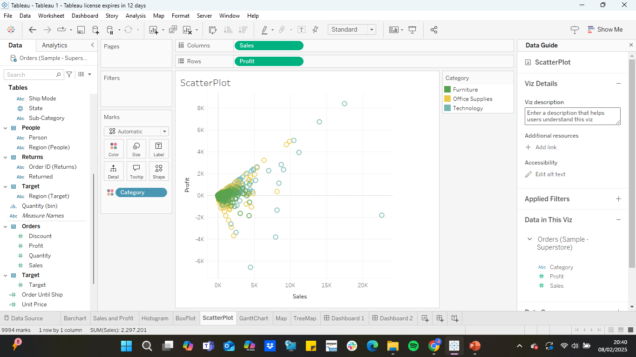
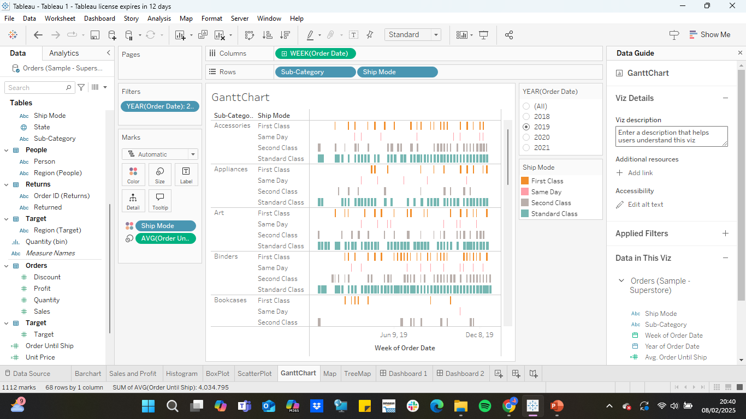
Building Charts in Tableau
Scatter Plot & Gantt Chart
Scatter Plot
Gantt Chart
Description: Showing Relationships Between Numeric Variables through Visualization
Description: Used to Display the Duration of a Certain Event or Activity
Page | 08

Slide 9
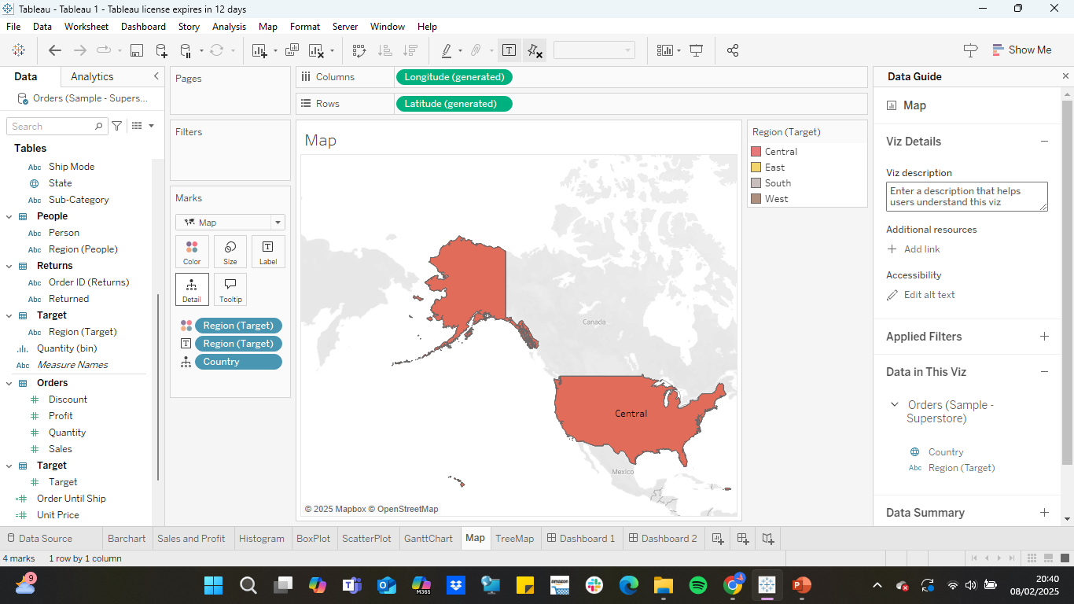
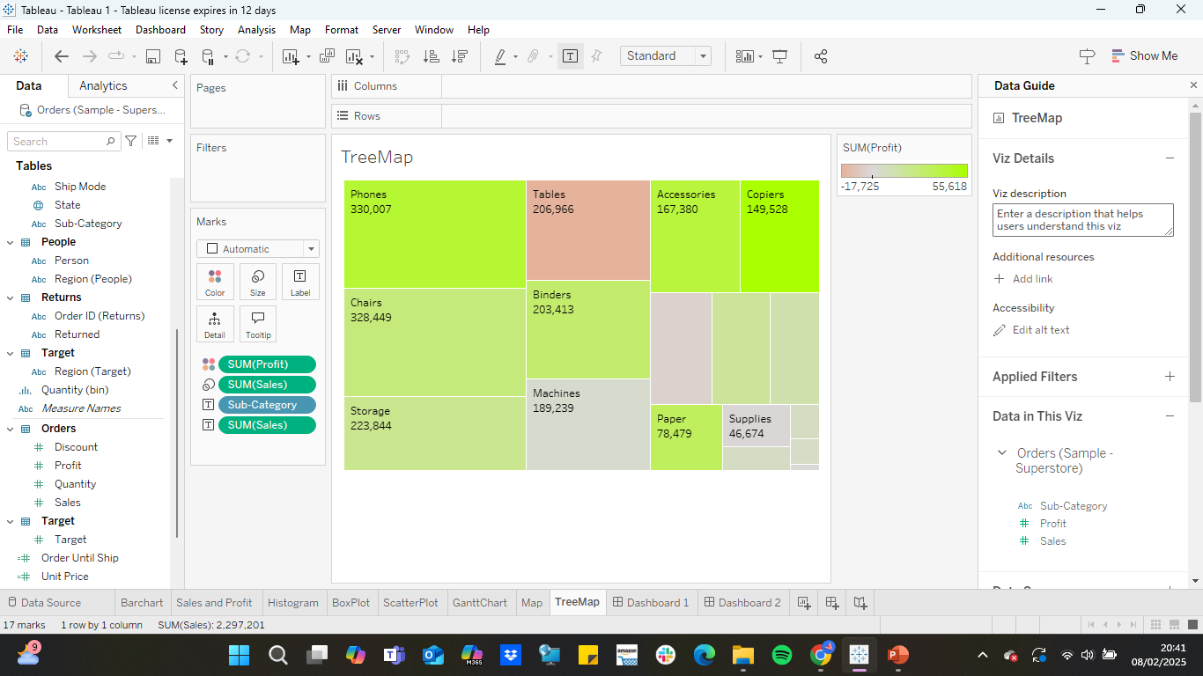
Building Charts in Tableau
Map & Treemap
Map
Treemap
Description: Shows Data Distribution Based on Region such as Country, City, Province, or Postal Code
Description: Displays category-based data in the form of proportionally sized rectangles based on their numeric values. This visualization helps in comparing parts of the whole and clearly identifying data patterns and proportions.
Page | 09

Slide 10
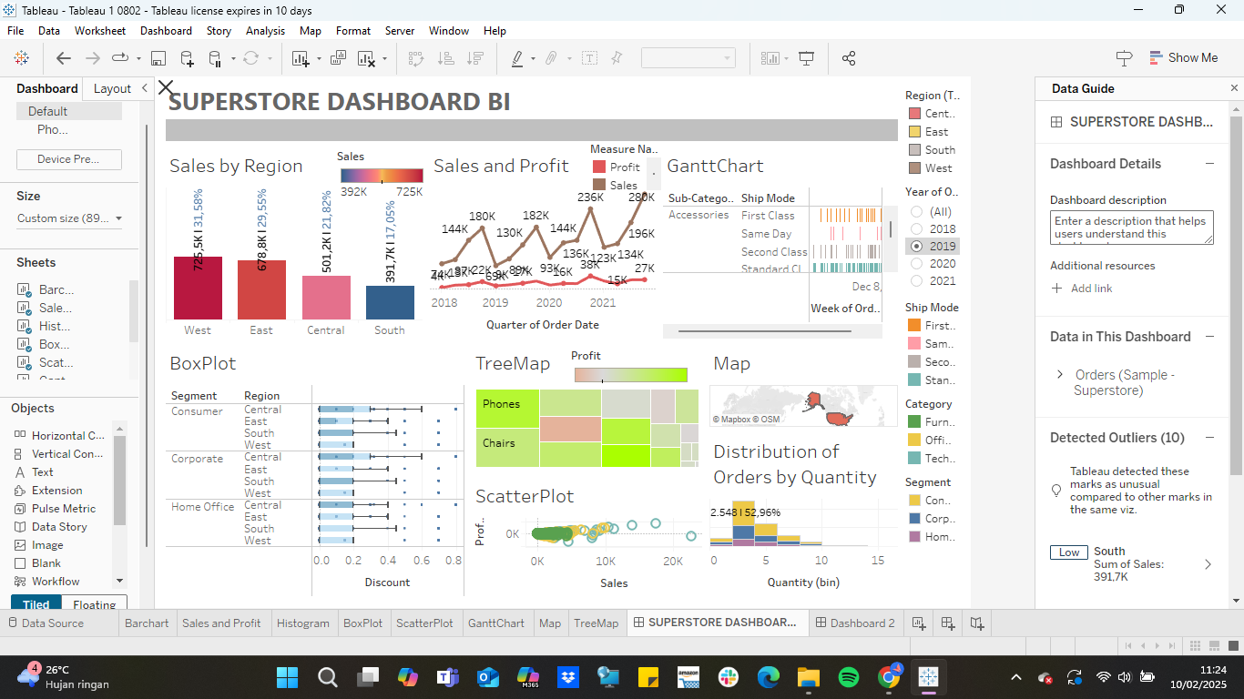
Dashboard
Page | 10

Slide 11

Thank you
Page | 10

